Slide 1
Activity Diagrams - Topics
What is an Activity?
Why do we need Activity diagram?
Activity Diagram – Notations
Activity Diagrams - Examples

Slide 2
What is an Activity?
Two definitions
  In a conceptual diagram, an activity is some task that needs to be done, whether by a human or a computer
  In a specification-perspective diagram or an implementation-perspective diagram, an activity is a method of a class
Activity arrangement
  Sequential – one activity is followed by another
  Parallel – two or more sets of activities are performed concurrently, and order is irrelevant
    Interleaving is permitted – we can jump between the parallel flows
Records the dependencies between activities, such as which things can happen in parallel and what must be finished before something else can start.

Slide 3
What is an Activity?
Activity Diagrams are used to describe activities
  Activity Diagrams are useful for describing complicated methods
  Activity Diagrams are useful for describing use cases, since, after all, a use case is an interaction, which is a form of activity
Using Activity Diagrams with Use Cases
  Start with a coarse-grained use case, which is composed of subordinate use cases
  For the complicated subordinate use cases, use Activity Diagrams rather than Use Case Diagrams
Activity Diagrams are like Flow Charts, but Flow Charts are usually limited to sequential activities while Activity Diagrams can show parallel activities as well

Slide 4
Notations
2. Transition
Activity1()
Activity2()
1. Activities

Slide 5
Notations
[x>0]
[x>0]
Activity1()
[x=0]
[x=0]
[x<0]
[x<0]
3. Decision Diamond

Slide 6
Notations
4.1 Synch. Bar (Join)
4.2 Splitting Bar (Fork)

Slide 7
Notations
Start Marker
Stop Marker
5. Start & Stop Markers

Slide 8
Notations
Subactivity
6. Subactivity
  A subactivity (state) starts another activity graph without using an operation.
  Used for functional decomposition, non-polymorphic applications, like many workflow systems.

Slide 9
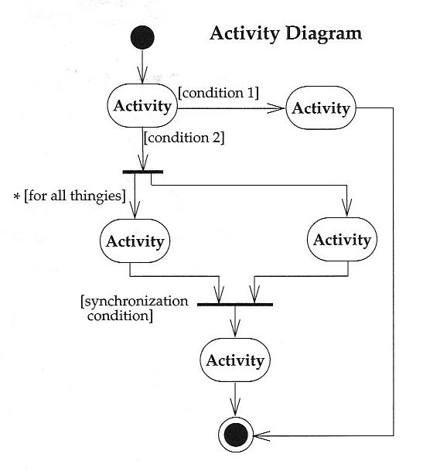
Activity Diagrams - Notation
Start at the top black circle
If condition 1 is TRUE, go right; if condition 2 is TRUE, go down
At first bar (a synchronization bar), break apart to follow 2 parallel paths
At second bar, come together to proceed only when both parallel activities are done

Slide 10
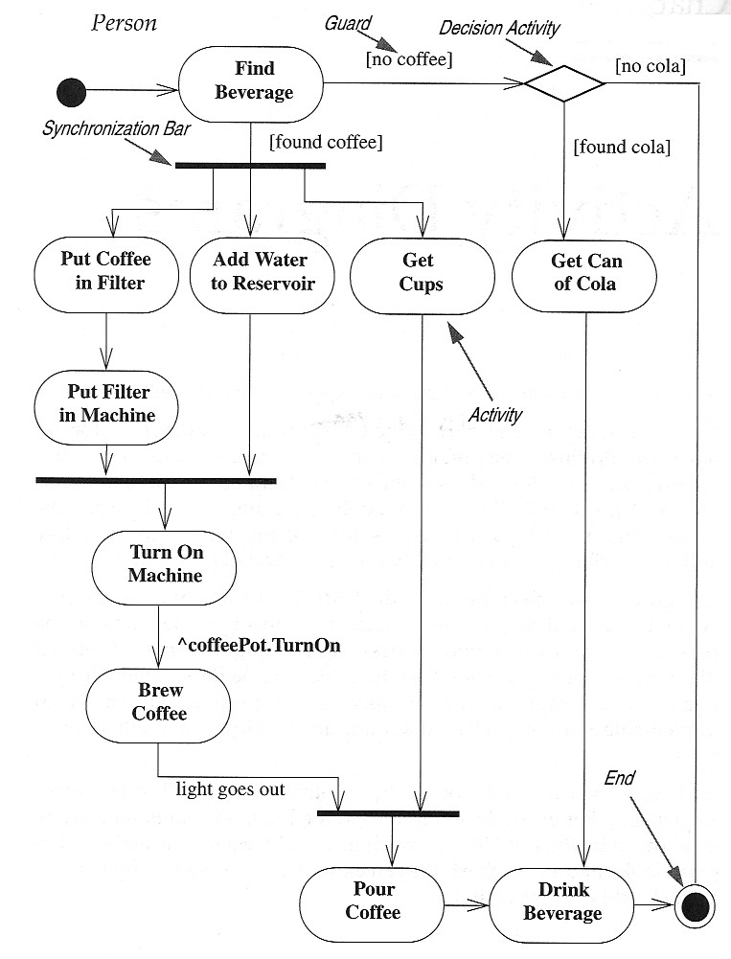
Activity Diagrams – Notation (concluded)
Activity – an oval
Trigger – path exiting an activity
Guard – each trigger has a guard, a logical expression that evaluates to “true” or “false”
Synchronization Bar – can break a trigger into multiple triggers operating in parallel or can join multiple triggers into one when all are complete
Decision Diamond – used to describe nested decisions (the first decision is indicated by an activity with multiple triggers coming out of it)

Slide 11
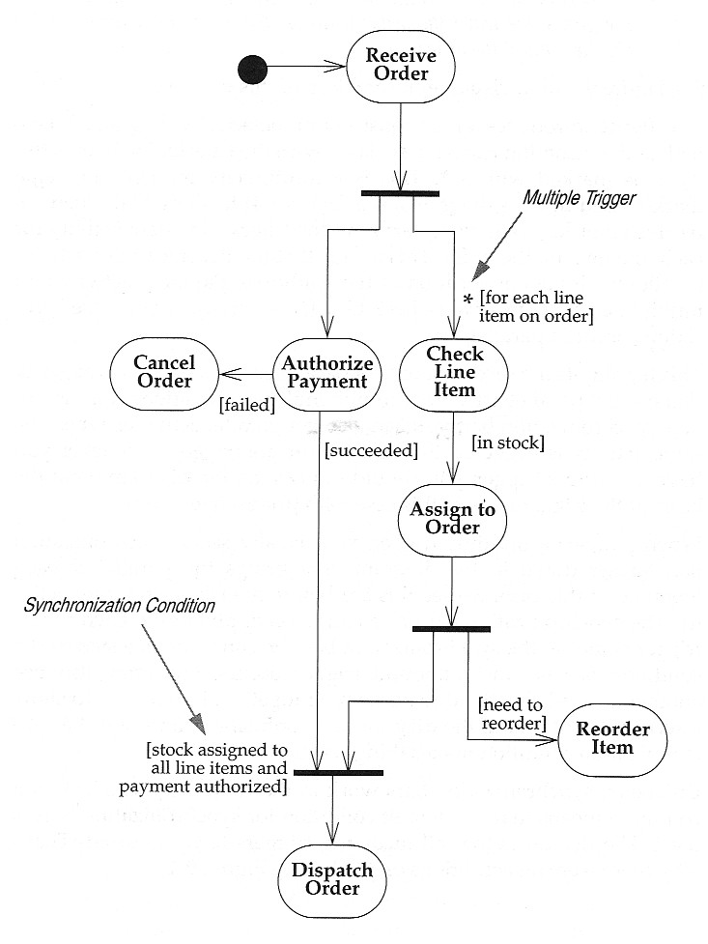
Activity Diagrams – Example
Use Case: Receiving an Order

Slide 12
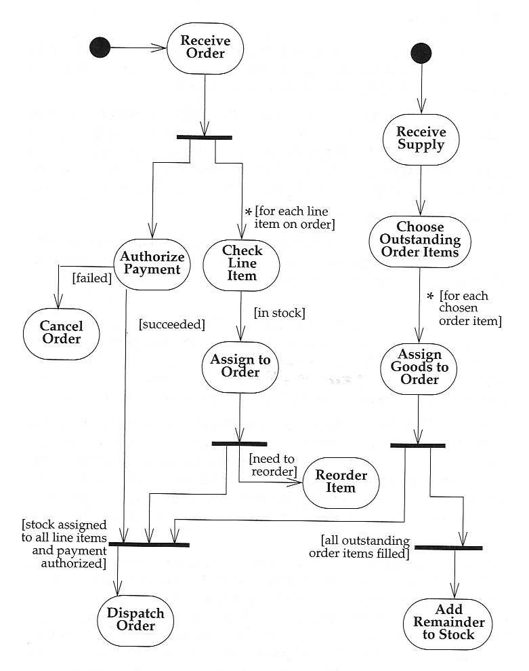
Activity Diagram – Example
Use Case: Receiving an Order and Receiving a Supply

Slide 13
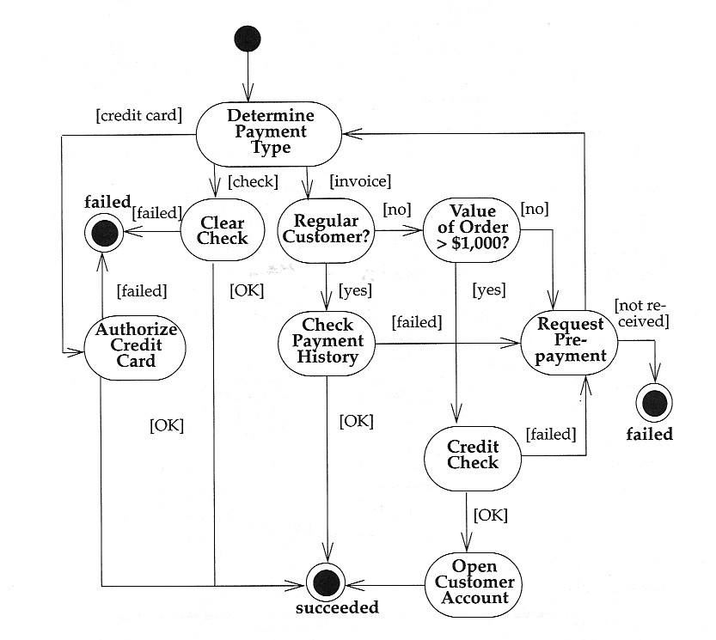
Activity Diagram – Example
Decomposing an Activity
An activity can be decomposed into a further Activity Diagram
When an Activity Diagram represents a decomposition of a higher-level activity, there can be only one start point

Slide 14
Drawback
Activity diagrams tell you what is happening, but not who does what.
In domain modeling, this diagram type does not convey which people or departments are responsible for each activity.
In programming, it does not convey which class is responsible for each activity.

Slide 15
Swimlanes
Arrange activity diagrams into vertical zones separated by dashed lines.
Each zone represents the responsibilities of a particular class or department.

Slide 16
Example: Activity Diagram (Swimlane) of the book return/borrow in Library
member
Librarian
[borrower]
Find book on shelf
[returning]
[returner]
Wait in queue
[borrowing]
Record return
Put book back of shelf
Record borrowing
Prepare for next
member

Slide 17
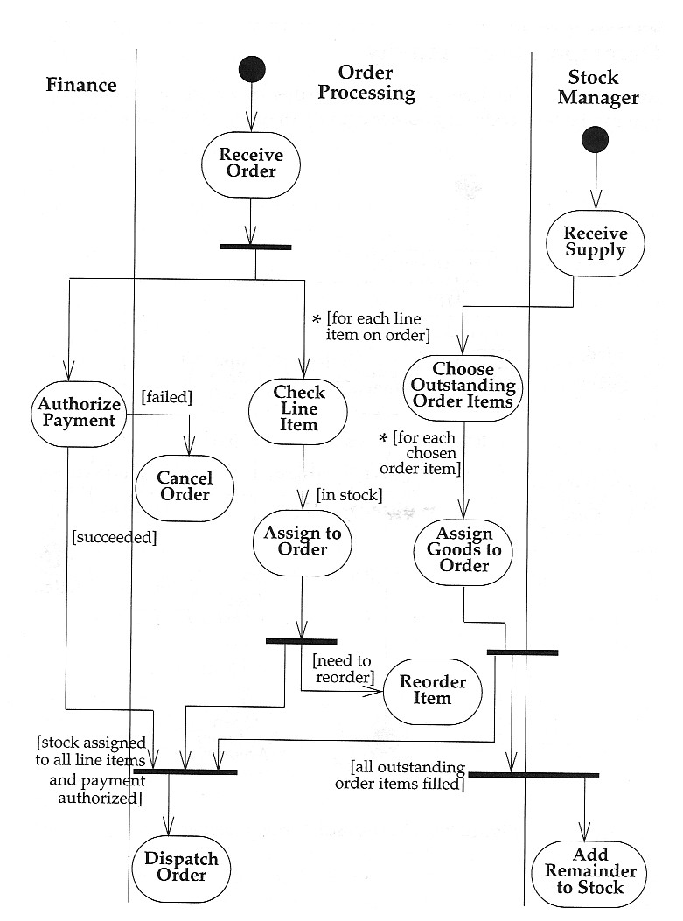
Activity Diagram – Example 4 of 5
Swimlanes - Activity Diagrams that show activities by class
Arrange activity diagrams into vertical zones separated by lines
Each zone represents the responsibilities of a particular class (in this example, a particular department)

Slide 18
When to Use Activity Diagrams
Do use them for
  Analysing Use Cases.
  Understanding workflow across many Use Cases.
  Dealing with multi-threaded applications.
Don’t use them
  to see how objects collaborate.
  to see how an object behaves over its lifetime.

Slide 19
